Slide 1
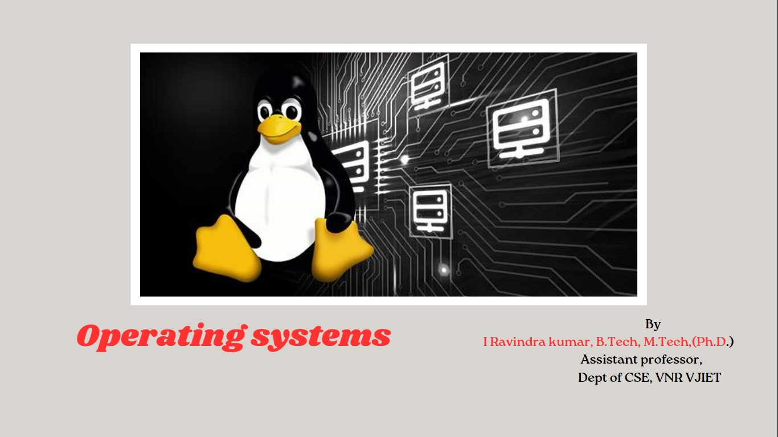
Operating system
By
I Ravindra kumar, B.Tech, M.Tech,(Ph.D.)
Assistant professor,
Dept of CSE, VNR VJIET

Slide 2
Inter process communication (Cooperating processes)
A cooperating process
  one that can affect or be affected by other processes executing in the system.
  can directly share a logical address space (that is, both code and data) or
  can be allowed to share data only through files or messages.
Messages
Shared Data

Slide 3















Bounded buffer Problem
our solution allows at most BUFFER.SIZE - 1 items in the buffer at the same time

Slide 4
One such interleaving is
T0: Producer execute register1=counter {register1=5}
T1: Producer execute register1=register1+1 {register1=6}
T2: Consumer execute register2=counter {register2=5}
T3: Consumer execute register2=register2-1 {register2=4}
T4: Producer execute counter=register1 {counter=6}
T5: Consumer execute counter=register2 {counter=4}
Race condition:
Where several processes access and manipulate the same data concurrently and the outcome of the execution depends on the particular order in which the access takes place

Slide 5
Critical Section
A solution to the critical-section problem must satisfy the following three requirements:
Mutual Exclusion:
  If process Pi is executing in its critical section, then no other processes can be executing in their critical sections.
2. Progress:
If no process is executing in its critical section and some processes wish to enter their critical sections, then only those processes that are not executing in their remainder section can participate in the decision on which will enter its critical section next, and this selection cannot be postponed indefinitely.
3. Bounded Waiting:
There exists a bound on the number of times that other processes are allowed to enter their critical sections after a process has made a request to enter its critical section and before that request is granted.

Slide 6
Two-Process Solutions/Peterson’s Solution
Applicable to only two processes at a time
The processes are numbered Po and P1.
When presenting Pi, we use Pj to denote the other process;
that is, j == 1 – i
Algorithm:
let the processes share a common integer variable turn
initialized to 0 (or 1). If turn == i, then process Pi is allowed to execute in its critical section

Slide 7
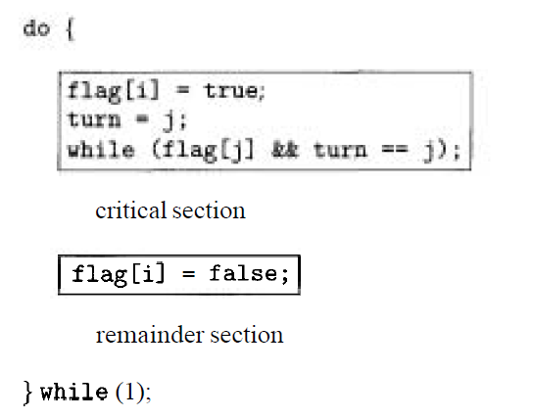
Boolean flag[2]; int turn;
Initially flag [0] = flag [1] = false

Slide 8
int turn;
Initially flag [0] = flag [1] = false
do{
Flag[0]=True
Turn=1;
While(flag[1] &&turn==1);
//Critical section
Flag[0]==False;
}while(1);
do{
Flag[1]=True
Turn=0;
While(flag[0] &&turn==0);
//Critical section
Flag[1]==False;
}while(1);

Slide 9
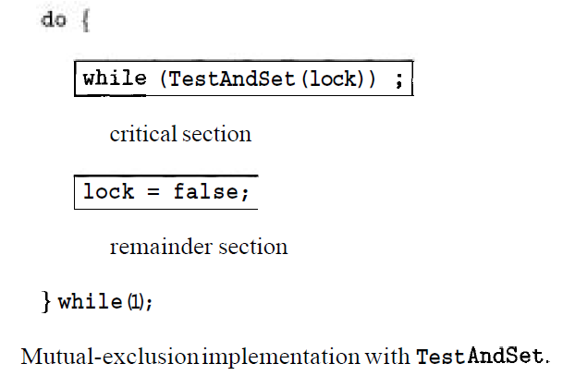
Synchronization Hardware
boolean TestAndSet(boo1ean &target) {
boolean rv = target;
target = true;
return rv;}

Slide 10
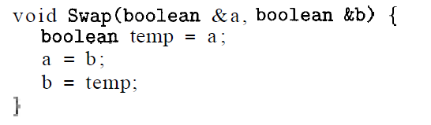
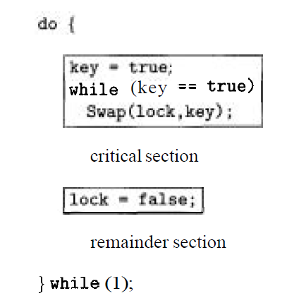

Slide 11

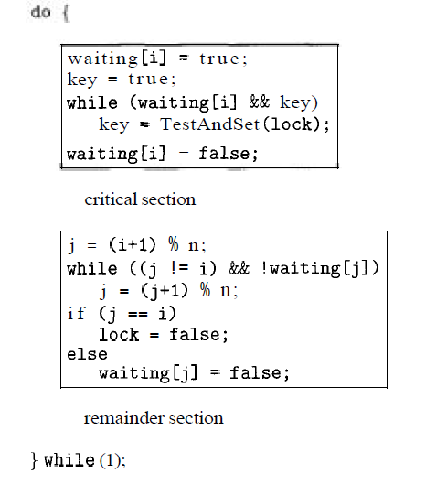

Slide 12
Semaphores
semaphore S is an integer variable that, apart from initialization, is accessed only through two standard atomic operations: wait and signal.
    wait(S) {
    while (S <=0) ; // no-op
    S --;
    }
    Signal(s)
    {
    S++;
    }

Slide 13
  Mutual-exclusion implementation with semaphores.
    do {
    wait (mutex) ;
    critical section
    signal (mutex) ;
    remainder section
    } while (1);
  Problem is Busy waiting
    typedef struct {
      int value ;
      struct process *L;
    } semaphore;

Slide 14
Each semaphore has an integer value and a list of processes.
When a process must wait on a semaphore, it is added to the list of processes.
A signal operation removes one process from the list of waiting processes and awakens that process
    void wait(semaphore S) {
      S.value--;
      if (S.value < 0) {
        add this process to S . L;
        block() ;
      }
    }

Slide 15
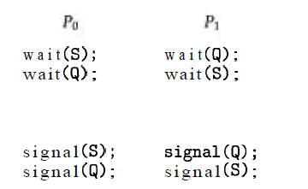
The signal semaphore operation can now be defined as
    void signal(semaphore S) {
      S.value++;
      if (S.value <= 0) {
      remove a process P from S . L ;
      wakeup (Pi) ;
      }
    }
Deadlock:
Starvation:
  a situation where processes wait indefinitely within the semaphore.
  if we add and remove processes from the list associated with a semaphore in LIFO order.

Slide 16
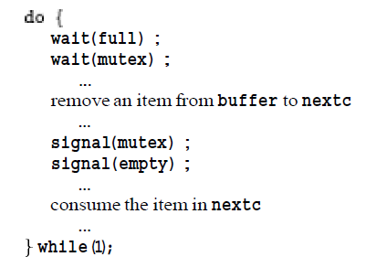
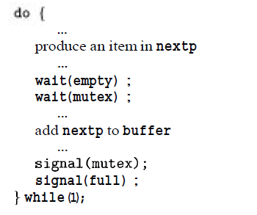
Classic Problems of Synchronization
The Bounded-Buffer Problem :
  The mutex semaphore provides mutual exclusion for accesses to the buffer pool and is initialized to the value 1.
  The empty and full semaphores count the number of empty and full buffers, respectively.

Slide 17
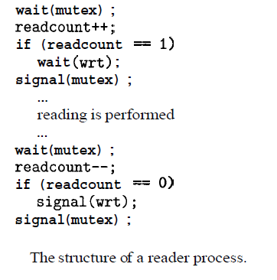
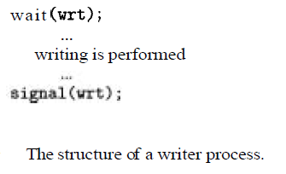
The Readers- Writers Problem
semaphore mutex, wrt;
int readcount;

Slide 18
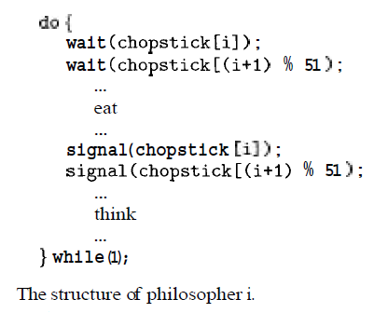
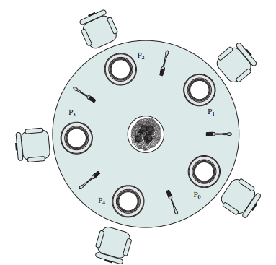
The Dining-Philosophers Problem
semaphore chopstick [5];

Slide 19
Solution
Allow at most four philosophers to be sitting simultaneously at the table.
Allow a philosopher to pick up her chopsticks only if both chopsticks are available (to do this she must pick them up in a critical section).
Use an asymmetric solution;
  an odd philosopher picks up first her left chopstick and then her right chopstick, whereas an even philosopher picks up her right chopstick and then her left chopstick.

Slide 20
Monitors
semaphore: but only if programmers use them properly
A monitor is essentially a class
all data is private
restrictions
  only one method within any given monitor object may be active at the same time.
  monitor methods may only access the shared data within the monitor and any data passed to them as parameters.
I.e. they cannot access any data external to the monitor.

Slide 21
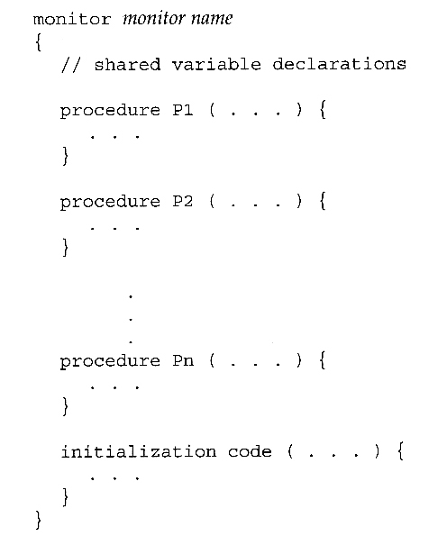
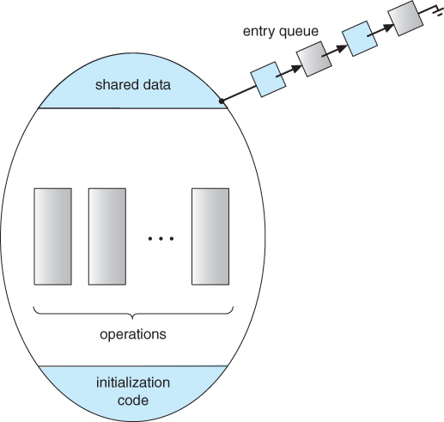

Slide 22
Condition:
A variable of type condition has only two legal operations,
wait and signal
I.e. if X was defined as type condition, then legal operations would be
X.wait( ) and X.signal( )
The wait operation blocks a process until some other process calls signal, and adds the blocked process onto a list associated with that condition.
The signal process does nothing if there are no processes waiting on that condition

Slide 23
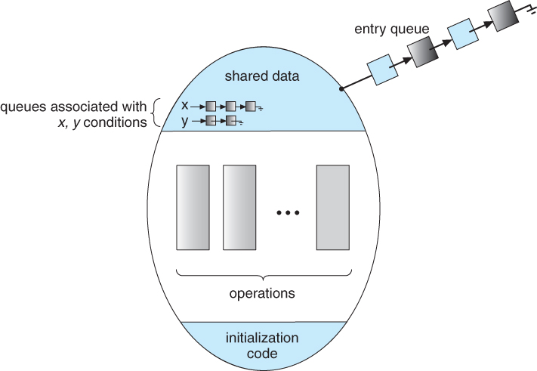

Slide 24
If process P within the monitor issues a signal that would wake up process Q also within the monitor,
then there would be two processes running simultaneously within the monitor,
violating the exclusion requirement.
Two possible solutions to this dilemma:
Signal and wait -
When process P issues the signal to wake up process Q, P then waits, either for Q to leave the monitor or on some other condition.
Signal and continue -
When P issues the signal, Q waits, either for P to exit the monitor or for some other condition.

Slide 25
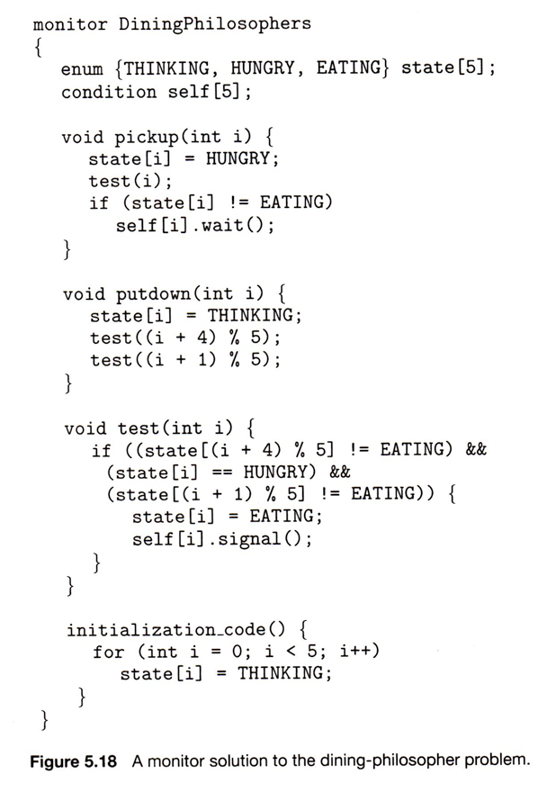

Slide 26

Thank YOU

